Slide 1

Topic : I’d card generator
DEPARTMENT OF INFORMATION TECHNOLOGY
Presented by:-Bhagyta mhatre(T150448518)
Sneha khollam(T150448515)
Snehal patil(T150448521)
Kirti patil(T150448520)
Pratikshabhosale(T150448503)
Guided by:- Harshal Mahajan sir

Slide 2
Abstract
Introduction
Problem Statement and objectives
Literature survey
Proposed System
System Architecture
Project Modules
Partial Implementation
Conclusion
Future Work
References

Slide 3
Introduction
Id card generator is basically a desktop application for generating I’d card .
As it needs time to make every students I’d card so this desktop application will help to make id card just by filling the information in the form and submit the request for generating I’d card and storing it in the database automatically.

Slide 4
Problem statement
The main objective of our project to reduce the human effort.
As it take much time to generate hard copy of I’d card , students can use the soft copy also ,till the hard copy gets generated.
Institute can generate and mail the soft copy of the id cards to respected students.

Slide 5
objectives
Simple to use.
Costs low.
Students can use the softcopy instead of waiting for getting the id card in a queue.
The main objective for selecting this project is to make id card process fully automated rather then doing it manually.
Since the student data was stores manually,
we have maked this process simple just submit the form and the data will stored in the database and id card will get generated less then a minute.

Slide 6
Literature survey
These are some websites and references from which we have got the idea for creating an id generator for our institute.
https://brainstormidsupply.com/
https://www.designhill.com/tools/id-maker
https://drawtify.com/free-id-card-maker/

Slide 7
Proposed system
We have used servlets as the user can easily interact with the user-interface , this ui consists of an html page.
The user should put just only the information about the student and hit submit , after that the id card will be automatically generated and along with that the student data will get inserted inside the mysql database.

Slide 8
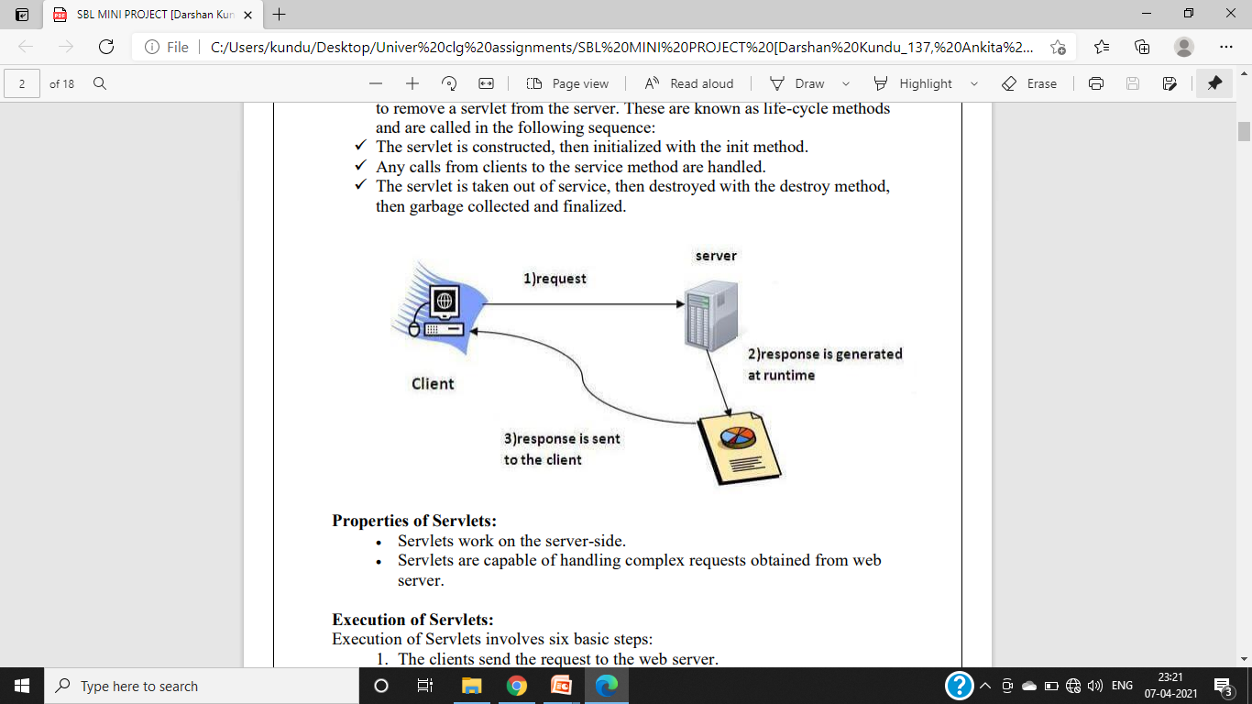
System architecture

Slide 9
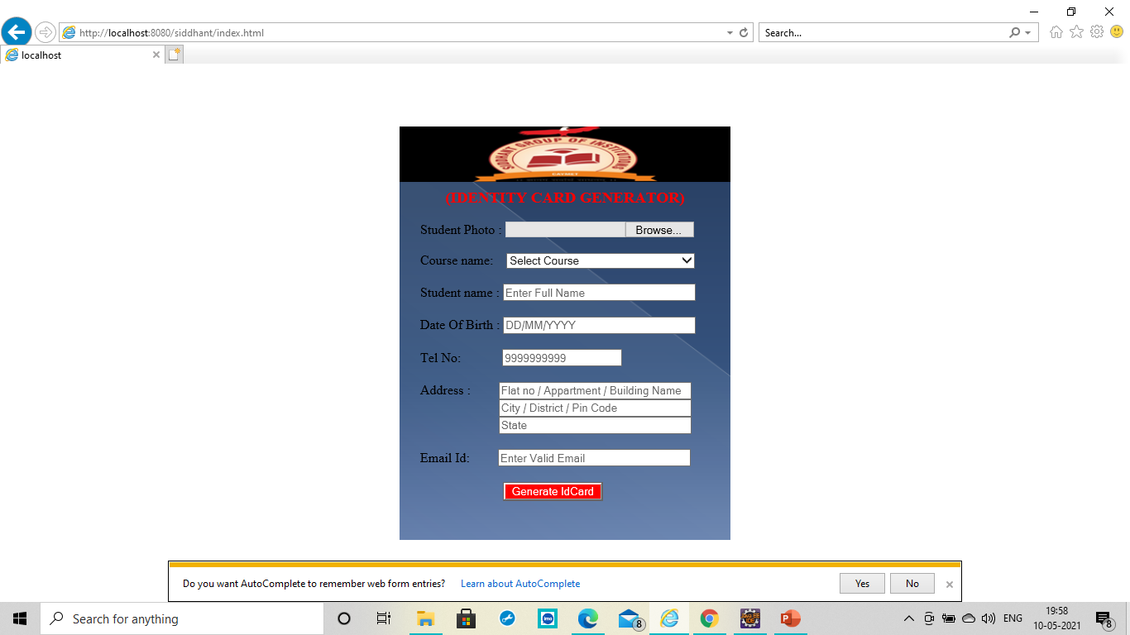
Project modules
Default page of our project named as index.html

Slide 10
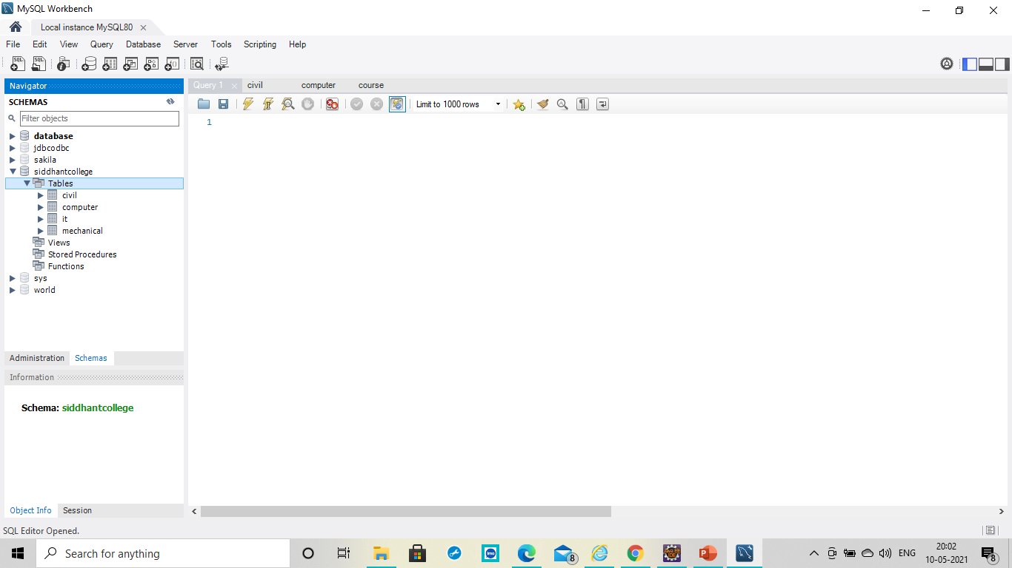
OverView of DataBase and Tables

Slide 11
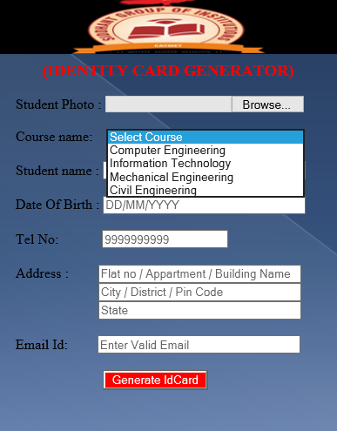
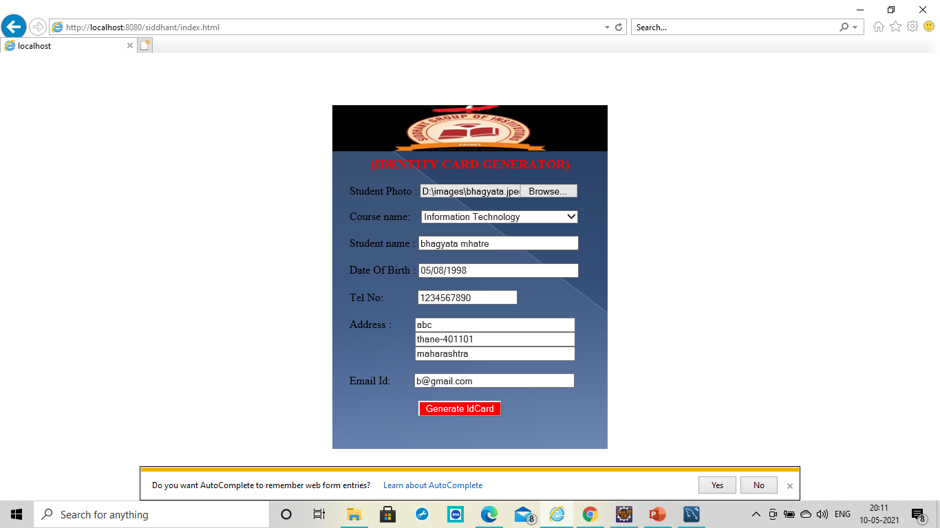

Slide 12
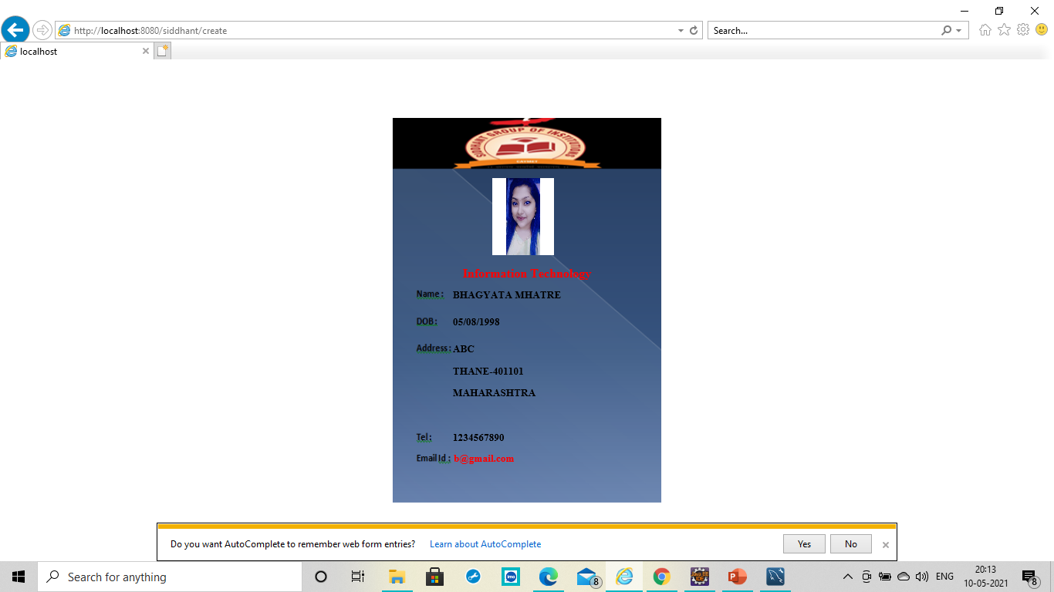

Slide 13
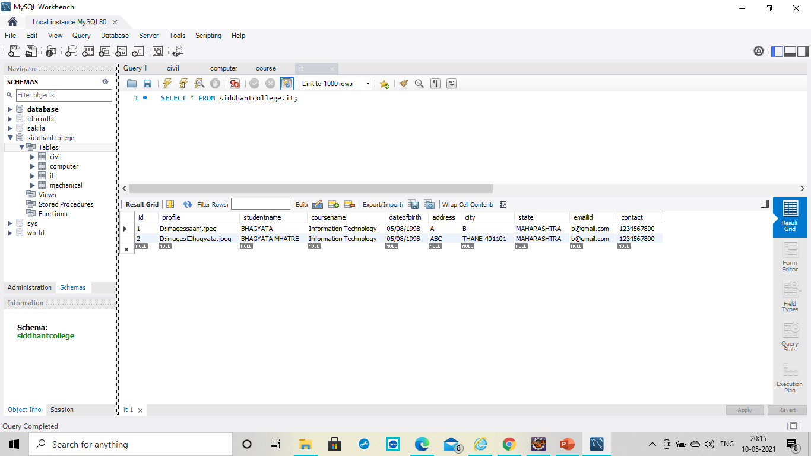

Slide 14
Partial implementation
Frontend
Html request page for filling student information.
Mysql connectivity using .jar file.
Response page for generates id card.
Backend
Fetched the data from
the client side.
load the data.
Converted data
into UpperCase.
Inserted data into the mysql
database using insert query.
Displayed that loaded data
in the id card response page.

Slide 15
conclusion
We understood the concept of servlets and using that we have created a project i:e id card generator.
We also understood how to handle the data and store it in the appropriate database using query.
Thus we have successfully build this project for our institute.

Slide 16
Future work
In future we can implement the QR-CODE which stores the details of the students.
These QR-CODES can be useful for taking attendance as during this pandemic we can’t take the risk of attendance through fingerprint , so we can just scan the QR-CODE and take the attendance.

Slide 17
references
https://en.wikipedia.org/wiki/servlets#:~:text=The%20Heaviside%20step%20function%2C%20or,and%20one%20for%20positive%20arguments
https://www.javatpoint.com
https://www.w3schools.com

Slide 19
ANY QUESTIONS.....?

